Slide 1
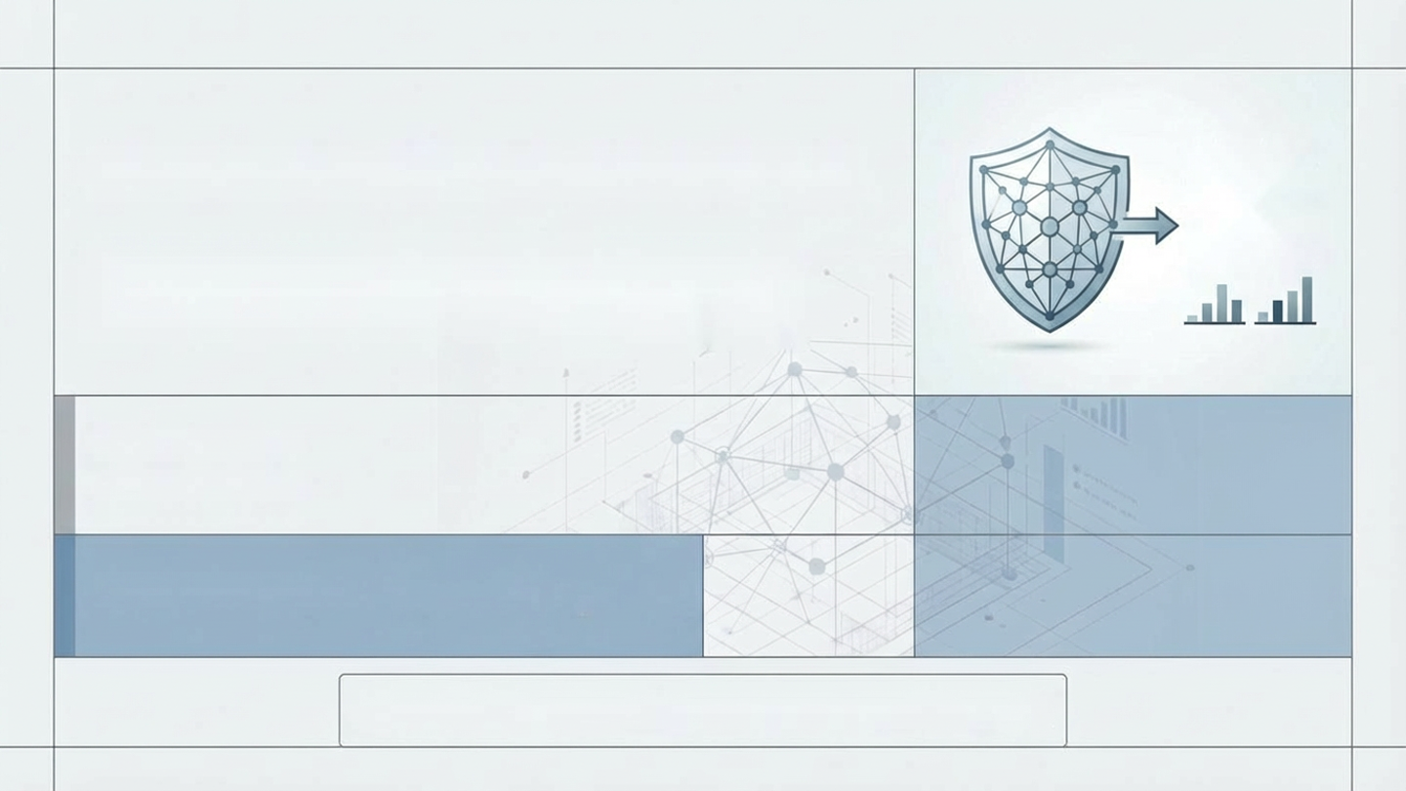
AI-POWERED SPAM SHIELD
01101010111010101
01101001010101010 010100081 01010000101101010 01101001101010101 10101001001010101 01001010101010101 01101101101100110
0101
SMS/Email Spam Detection System using Machine Learning & GenAl
Daksh Chaurasia
Suhail Mohammad
Dheeraj Thirunala
Lalith Sathwik
DEVELOPEDBY:
Group 7
ACADEMICPURPOSE –GenAI/ML Project
LIVE DEMo:https://web-production-1eef.up.railway.app/

Slide 2
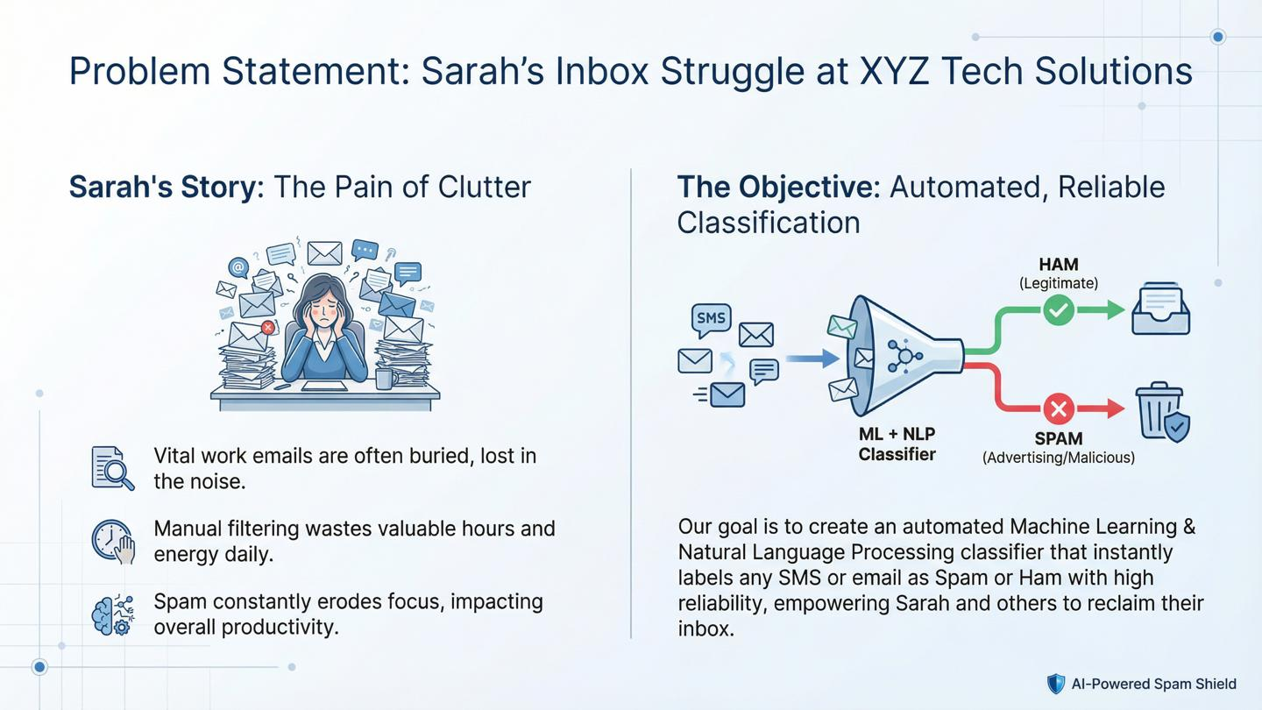

Slide 3
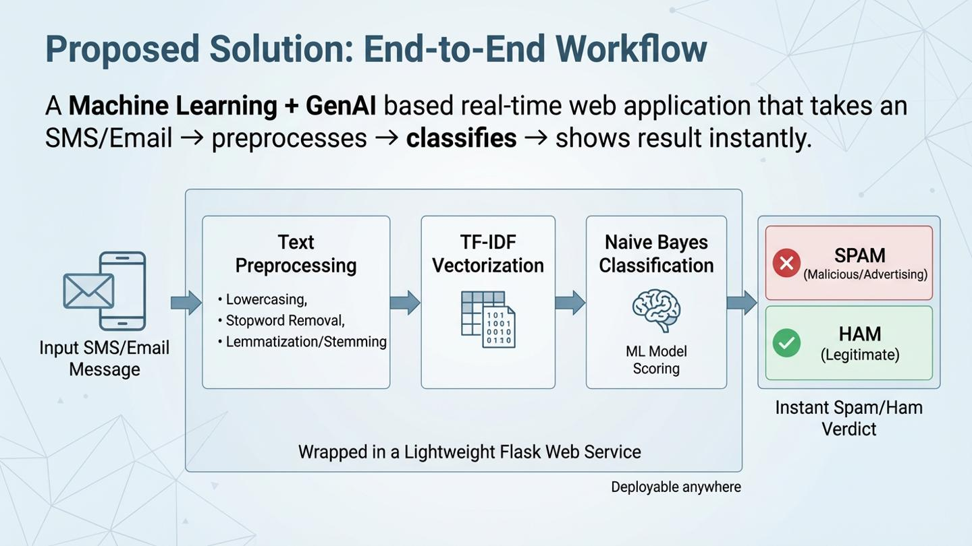

Slide 4
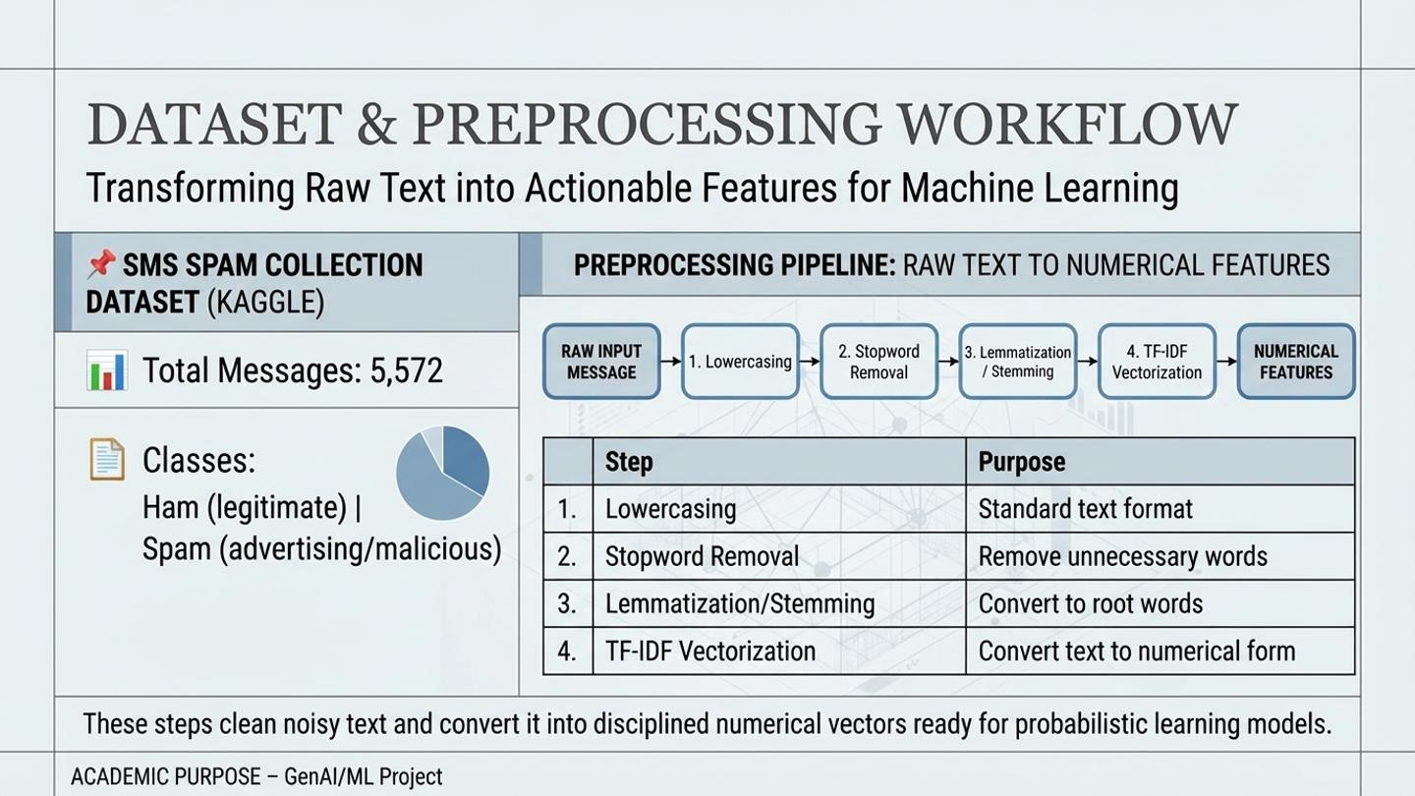

Slide 5
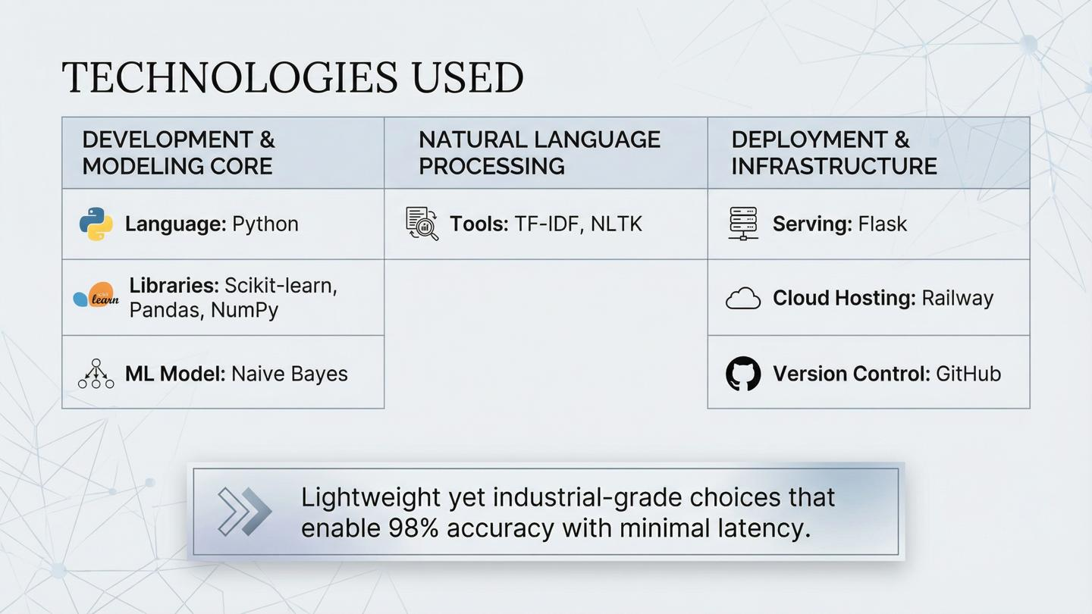

Slide 6
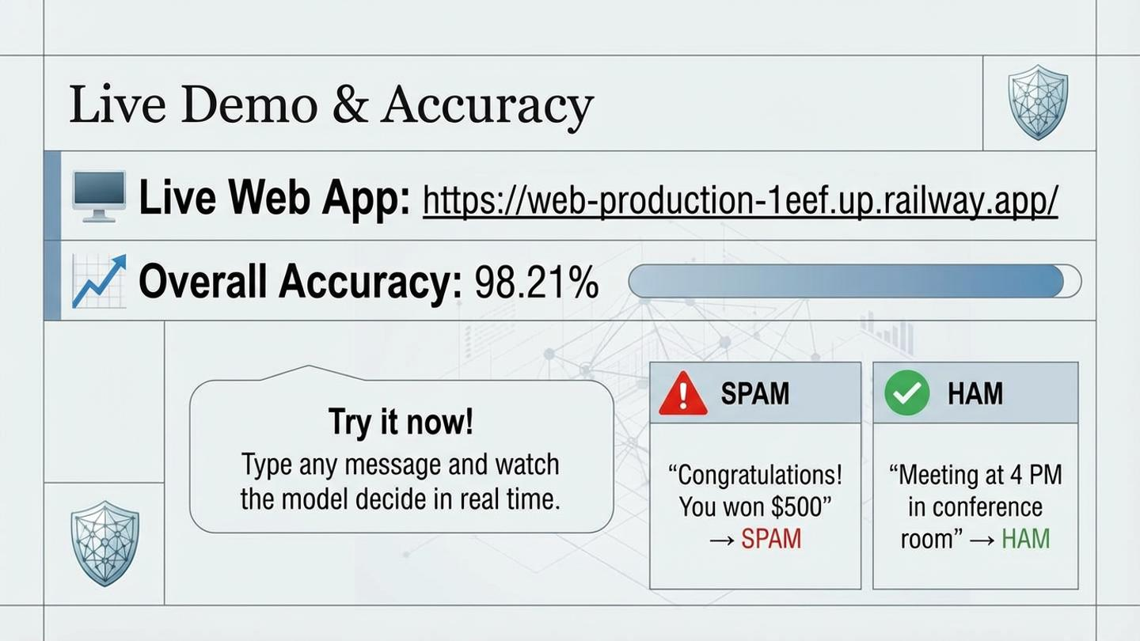

Slide 7
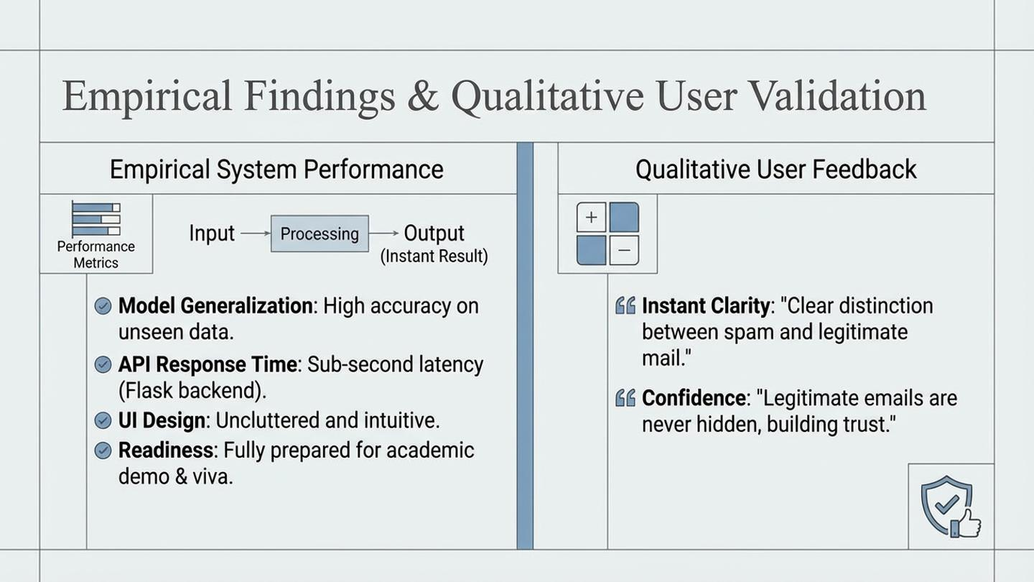

Slide 8
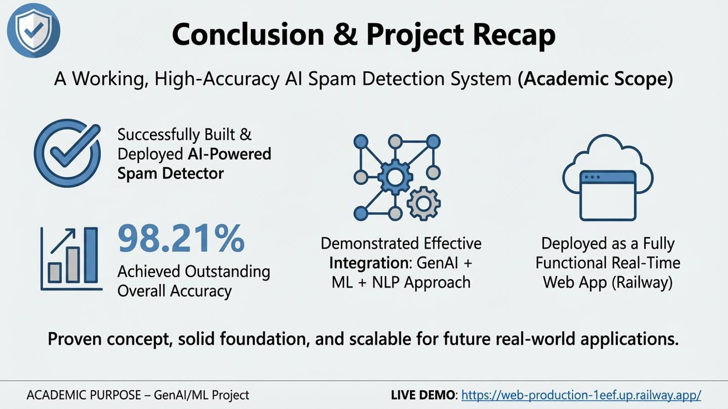

Slide 9
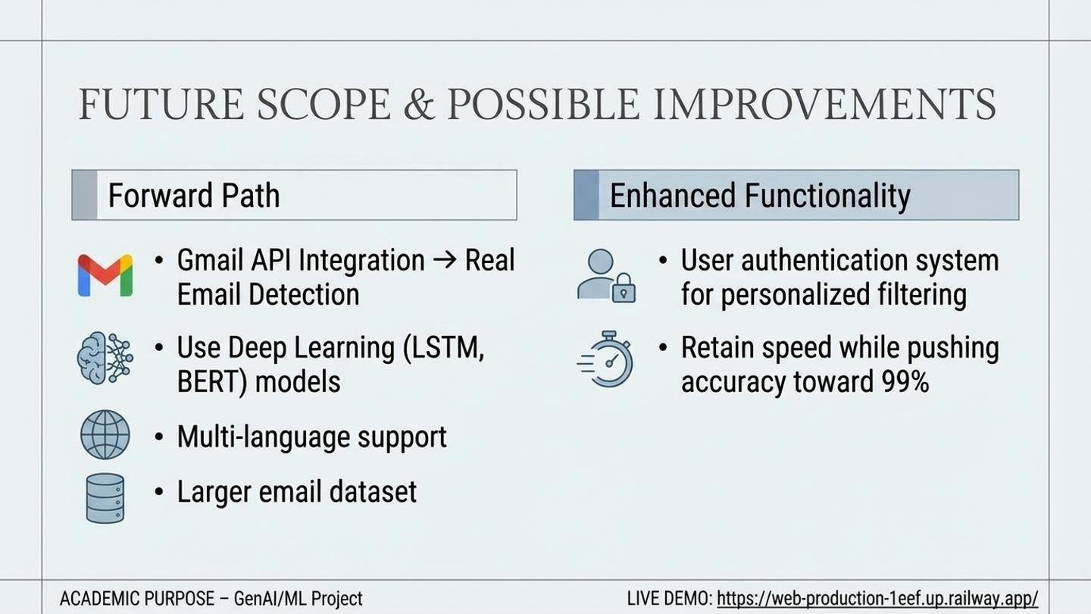

Slide 10
